Slide 1

5 Best practices for F# Development

Slide 2



DANiel mohl
Sommet Group
dmohl@yahoo.com
www.twitter.com/dmohl
blog.danielmohl.com

Slide 3
HOW THIs will work
1. Define the Best Practice
2. Explain Why It’s Good
3. Provide Concrete Examples

Slide 4

PROGRAMMING IN THE SMALL
Prefer small functions with only one primary responsibility.

Slide 5
Why is it good?
1. Helps enable function composition
2. Follows the Single Responsibility Principle (SRP)

Slide 6
Examples
1. FSharpCouch
2. IoC Container

Slide 7

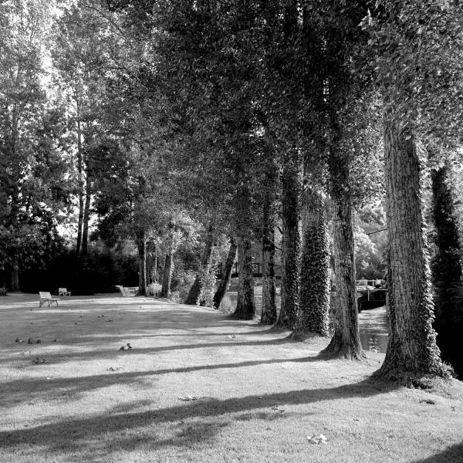

Function composition
Prefer function composition over argument passing.

Slide 8
Why is it good?
1. Allows for function chaining
2. Makes the code terse yet readable

Slide 9
Examples
1. Asynchronous Workflows
2. WebSharper 2010

Slide 10

Tail Recursive functions
Make sure your recursive functions are tail recursive.

Slide 11
Why is it good?
1. Without it, there’s a risk for a stack overflow
2. Tail Call Optimization (TCO)

Slide 12
Examples
1. Tail Recursive vs. Non-Tail Recursive
2. Polyphony (Join the Node Cluster)

Slide 13
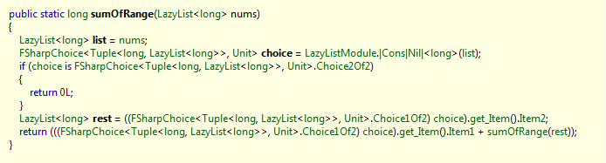
Verifying tail recursion
Not tail recursive

Slide 14
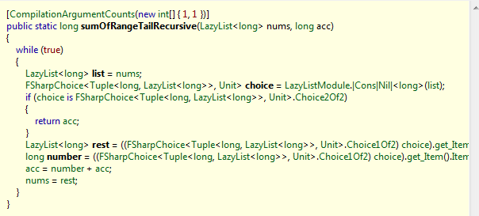
Verifying tail recursion
tail recursive

Slide 15
Active patterns
Prefer active patterns over multiple ‘when guards’ during pattern matching.

Slide 16
Why is it good?
1. Makes code more readable
2. Supports Don’t Repeat Yourself (DRY)

Slide 17
Type of active patterns
Single-Case
Example: let (|UpperCase|) (x:string) =…
Multi-Case
Example: let (|Odd|Even|) x =…
Partial
Example: let (|DivisibleByTwo|_|) input =…
Parameterized
Example: let (|MultipleOf|_|) x input = …
- http://blogs.msdn.com/b/chrsmith/

Slide 18
Examples
1. Example of Active Patterns (XML parse)
2. Node Join in Polyphony (DHT)

Slide 19

Pattern Matching
Prefer pattern matching to if/else syntax.

Slide 20
Why is it good?
1. Makes your code easier to extend
2. Helps get you out of the procedural mindset

Slide 21
Examples
1. MVC Template (Account Controller)

Slide 22
Daniel mohl
Sommet Group
dmohl@yahoo.com
www.twitter.com/dmohl
blog.danielmohl.com

